Slide 1
We can track you if you take the metro
Tracking metro riders using Accelerometers
151220102
万子文

Slide 2
Introduction
Background
Overview
Details
CONTENTS
Experiment
Conclusion

Slide 3
PPT模板下载：www.1ppt.com/moban/ 行业PPT模板：www.1ppt.com/hangye/
节日PPT模板：www.1ppt.com/jieri/ PPT素材下载：www.1ppt.com/sucai/
PPT背景图片：www.1ppt.com/beijing/ PPT图表下载：www.1ppt.com/tubiao/
优秀PPT下载：www.1ppt.com/xiazai/ PPT教程： www.1ppt.com/powerpoint/
Word教程： www.1ppt.com/word/ Excel教程：www.1ppt.com/excel/
资料下载：www.1ppt.com/ziliao/ PPT课件下载：www.1ppt.com/kejian/
范文下载：www.1ppt.com/fanwen/ 试卷下载：www.1ppt.com/shiti/
教案下载：www.1ppt.com/jiaoan/ PPT论坛：www.1ppt.cn
Introduction

Slide 4
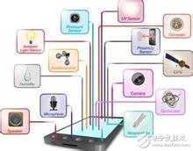
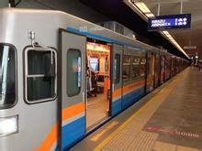
Sensor-rich mobile devices have become ubiquitous.
Once these sensors are hijacked by malware , they may seriously threaten the user privacy.
Easy to get permission
Affect a large population
Other private information may be further inferred

Slide 5
Our contributions
1
We are the ﬁrst to propose an accelerometer-based side channel attack for inferring metro riders’ traces.
2
We propose an improved attack that only requires the attacker to collect labeled data from a very small set of station intervals with obvious characteristics
3
We conduct real experiments on six metro lines in three major cities to evaluate the effectiveness of the proposed attack.

Slide 6
PPT模板下载：www.1ppt.com/moban/ 行业PPT模板：www.1ppt.com/hangye/
节日PPT模板：www.1ppt.com/jieri/ PPT素材下载：www.1ppt.com/sucai/
PPT背景图片：www.1ppt.com/beijing/ PPT图表下载：www.1ppt.com/tubiao/
优秀PPT下载：www.1ppt.com/xiazai/ PPT教程： www.1ppt.com/powerpoint/
Word教程： www.1ppt.com/word/ Excel教程：www.1ppt.com/excel/
资料下载：www.1ppt.com/ziliao/ PPT课件下载：www.1ppt.com/kejian/
范文下载：www.1ppt.com/fanwen/ 试卷下载：www.1ppt.com/shiti/
教案下载：www.1ppt.com/jiaoan/ PPT论坛：www.1ppt.cn
Background

Slide 7
Side-channel attack
“
In cryptography, a side-channel attack is any attack based on information gained from the physical implementation of a cryptosystem, rather than brute force or theoretical weaknesses in the algorithms (compare cryptanalysis)
”

Slide 8

Classifier
分类问题可以做如下定义：
$C$={$Y_{1}$, $Y_{2}$,…, $Y_{n}$}, $I$={$X_{1}$, $X_{2}$,…, $X_{m}$}
确定映射规则：$y=f(x)$,使得任意$x_{i}∈I$,有且仅有一个$y_{i}∈C$,使得$y_{i}=f(x_{i})成立$
我们在算法的设计中使用最基本的分类器：朴素贝叶斯分类器

Slide 9
PPT模板下载：www.1ppt.com/moban/ 行业PPT模板：www.1ppt.com/hangye/
节日PPT模板：www.1ppt.com/jieri/ PPT素材下载：www.1ppt.com/sucai/
PPT背景图片：www.1ppt.com/beijing/ PPT图表下载：www.1ppt.com/tubiao/
优秀PPT下载：www.1ppt.com/xiazai/ PPT教程： www.1ppt.com/powerpoint/
Word教程： www.1ppt.com/word/ Excel教程：www.1ppt.com/excel/
资料下载：www.1ppt.com/ziliao/ PPT课件下载：www.1ppt.com/kejian/
范文下载：www.1ppt.com/fanwen/ 试卷下载：www.1ppt.com/shiti/
教案下载：www.1ppt.com/jiaoan/ PPT论坛：www.1ppt.cn
Overview

Slide 10
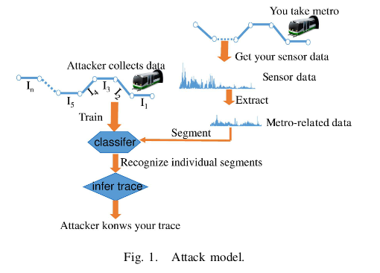
Metro-Related Data Extraction
Filter out metro-related data from the mixed sensor reading
Data Segmentation and Recognition
station intervals are the basic recognition primitives for the classiﬁer
Metro-ride Trace Inferring
Applies the interval classiﬁer to map these data segments to station intervals.

Slide 11
PPT模板下载：www.1ppt.com/moban/ 行业PPT模板：www.1ppt.com/hangye/
节日PPT模板：www.1ppt.com/jieri/ PPT素材下载：www.1ppt.com/sucai/
PPT背景图片：www.1ppt.com/beijing/ PPT图表下载：www.1ppt.com/tubiao/
优秀PPT下载：www.1ppt.com/xiazai/ PPT教程： www.1ppt.com/powerpoint/
Word教程： www.1ppt.com/word/ Excel教程：www.1ppt.com/excel/
资料下载：www.1ppt.com/ziliao/ PPT课件下载：www.1ppt.com/kejian/
范文下载：www.1ppt.com/fanwen/ 试卷下载：www.1ppt.com/shiti/
教案下载：www.1ppt.com/jiaoan/ PPT论坛：www.1ppt.cn
Details

Slide 12
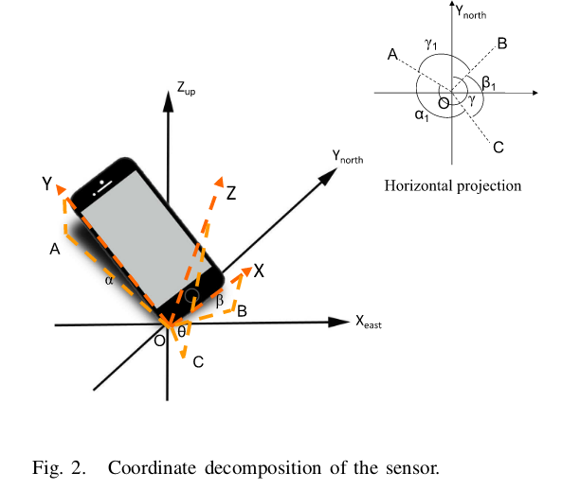
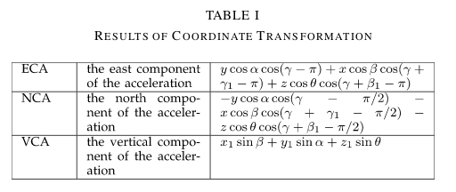
Coordinate Transformation
α is the angle between the Y -axis with respect to the horizontal plane
β is the angle of the X -axis and the horizontal
γ is the angle between the horizontal projection of the Y –axis of the phone system and true north

Slide 13
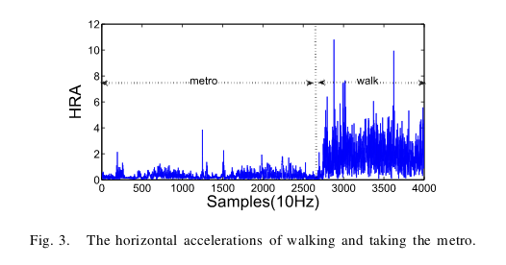
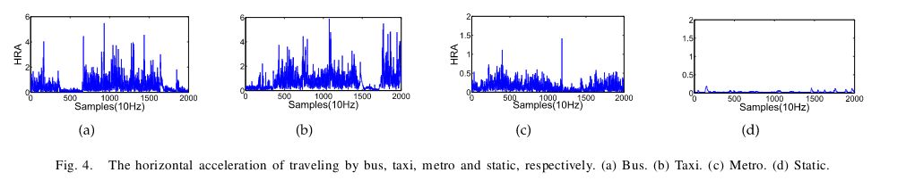
Extraction of Metro Related Data
We can observe a sharp difference that the amplitude of metro data is much smaller than that of the non-metro data.

Slide 14
Extraction of Metro Related Data
1
The classiﬁcation result is binary: either metro or non-metro
2
Input : a sequence of HRA values
(m-sample sliding window)
3
Five statistical measures of the HRA values : mean , variance and the numbers of samples that surpass three pre-deﬁned thresholds

Slide 15
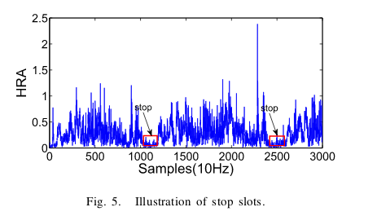
Segmentation of Metro Related Data
We can observe that there exist a series of periodic slots where the values are much smaller than those of other positions. According to our analysis , these slots rightly correspond to the stop periods of the train.

Slide 16
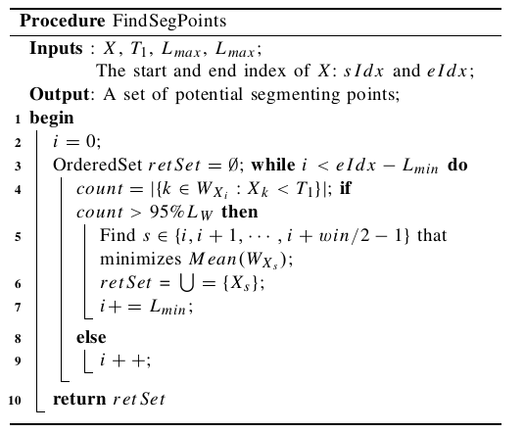
Segmentation of Metro Related Data
The proposed algorithm deﬁnes a sliding window W .
It moves forward W from X one value by one value
$|\{k∈\left\{i,i+1,…,i+L_{W}−1\right\}:X_{k}<T_{1}\}$|>95%$L_{W}$

Slide 17
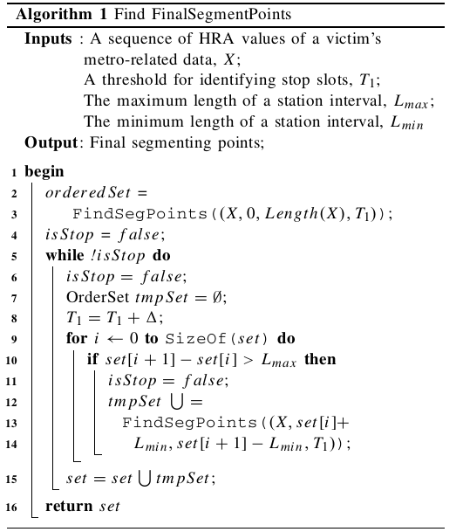

Segmentation of Metro Related Data
Note that, false segmenting points can be avoided by making $T_{1}$ small enough
If some segmenting points have been missed , just increase $T_{1}$

Slide 18
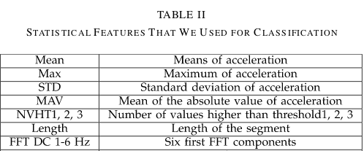
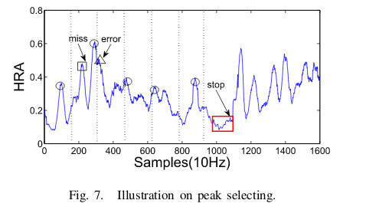
Recognition of the Stations
a)STATISTICAL FEATURES
b)PEAK FEATURES

Slide 19
Error-Tolerant Trace Inferring
For each data segment, we take into account not only its optimal mapping but also other possibilities.
Our ﬁnal inferring result comprehensively considers the classiﬁcation results of all the member segments in a trace.

Slide 20
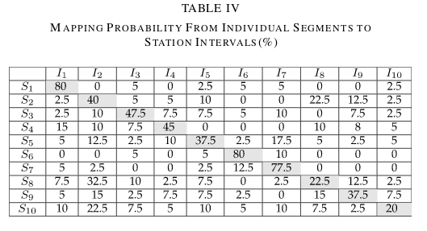


Error-Tolerant Trace Inferring
${[P_{i,j}]}_{n×m}$ denotes the
Probability that data segment$S_{i}$ is mapped to station $I_{j}$
${Vote\left(Pbti\right)=\sum_{j=1}^{n}{P}}_{j,i+j−1}$

Slide 21
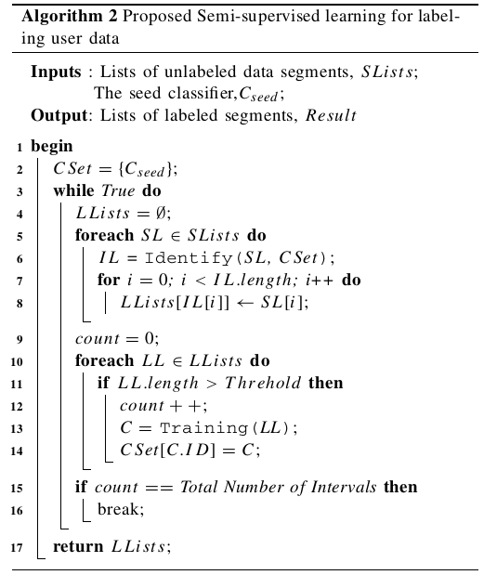
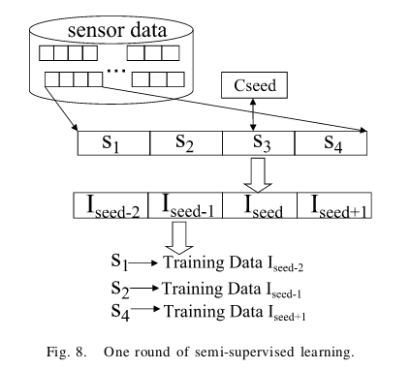
SEMI -SUPERVISED LEARNING

Slide 22
PPT模板下载：www.1ppt.com/moban/ 行业PPT模板：www.1ppt.com/hangye/
节日PPT模板：www.1ppt.com/jieri/ PPT素材下载：www.1ppt.com/sucai/
PPT背景图片：www.1ppt.com/beijing/ PPT图表下载：www.1ppt.com/tubiao/
优秀PPT下载：www.1ppt.com/xiazai/ PPT教程： www.1ppt.com/powerpoint/
Word教程： www.1ppt.com/word/ Excel教程：www.1ppt.com/excel/
资料下载：www.1ppt.com/ziliao/ PPT课件下载：www.1ppt.com/kejian/
范文下载：www.1ppt.com/fanwen/ 试卷下载：www.1ppt.com/shiti/
教案下载：www.1ppt.com/jiaoan/ PPT论坛：www.1ppt.cn
Experiment

Slide 23
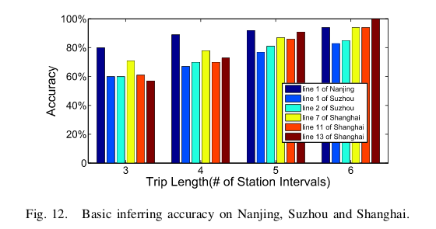
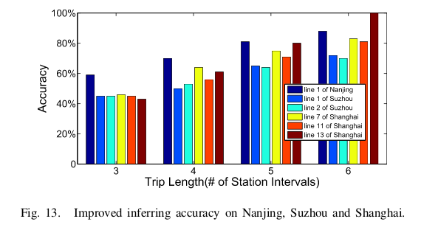
Accuracy

Slide 24
PPT模板下载：www.1ppt.com/moban/ 行业PPT模板：www.1ppt.com/hangye/
节日PPT模板：www.1ppt.com/jieri/ PPT素材下载：www.1ppt.com/sucai/
PPT背景图片：www.1ppt.com/beijing/ PPT图表下载：www.1ppt.com/tubiao/
优秀PPT下载：www.1ppt.com/xiazai/ PPT教程： www.1ppt.com/powerpoint/
Word教程： www.1ppt.com/word/ Excel教程：www.1ppt.com/excel/
资料下载：www.1ppt.com/ziliao/ PPT课件下载：www.1ppt.com/kejian/
范文下载：www.1ppt.com/fanwen/ 试卷下载：www.1ppt.com/shiti/
教案下载：www.1ppt.com/jiaoan/ PPT论坛：www.1ppt.cn
Conclusion

Slide 25
In this paper, we have proposed a basic attack which can extract metro-related data from mixed acceleration readings .
A
then use an interval classier built from supervised learning to infer users ’ trace .
B
C
We conduct real experiment on 6 metro lines in 3 major cities . The highest accuracy can reach 94%.

Slide 26
感谢聆听

